Slide 1
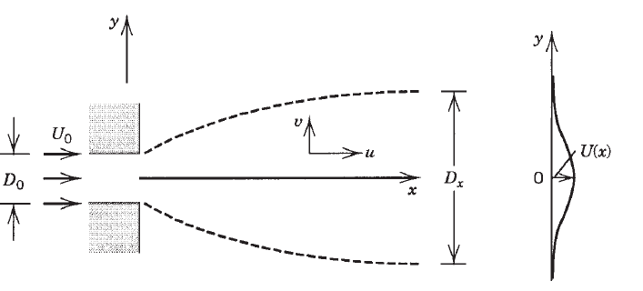
Problem
Consider the development of a two-dimensional laminar jet discharging in the x direction into a fluid reservoir that contains the same fluid as the jet (Fig). The reservoir pressure P∞ is uniform. The jet is generated by a narrow slit of width D₀; the average fluid velocity through the slit is U₀.
Let D(x) and U(x) be the jet thickness scale and the centerline velocity scale at a sufficiently long distance x away from the nozzle (the slit). Relying on the mass and momentum conservation equations, on boundary layer theory (D << x), and on scale analysis in a flow region of length x and thickness D, determine the order of magnitude of D and U in terms of D₀, U₀, x, and ν:

Slide 2
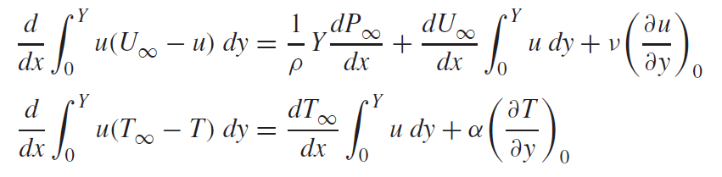
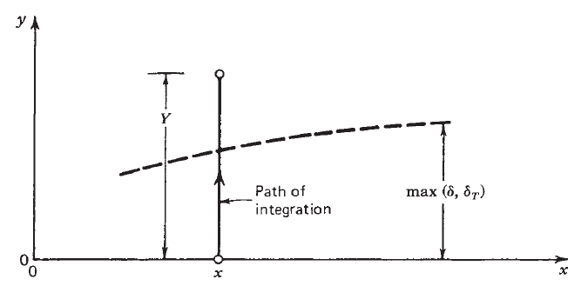
Integral solutions
Integral boundary layer equations for momentum and energy
(1)
(2)

Slide 3
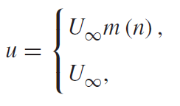
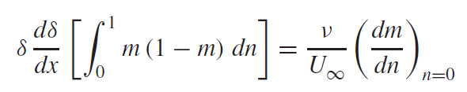
Velocity profile
Assume uniform flow (U∞, P∞ = constants)
Assume that the shape of the longitudinal velocity profile is described by
(3)
Substituting into equation (1) gives

Slide 4
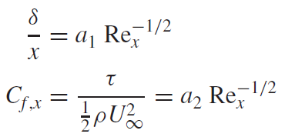
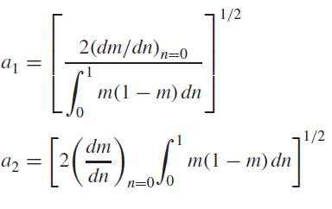
The resulting expressions for local boundary layer thickness and skin friction coefficient are
with the following notation:

Slide 5


Temperature profile
Heat transfer coefficient information is extracted in a similar fashion from eq. (2) with dT∞/dx = 0
(4)
1. For high-Pr fluids,
Integral energy equation (2) reduces to

Slide 6

1. For low-Pr fluids (liquid metals),
Integral energy equation (2) reduces to
The sum of two integrals stems from the fact that when δ_{T} >> δ, immediately next to the wall (0 < y < δ), the velocity is described by the assumed shape U∞m, whereas for (δ < y < δ_{T}), the velocity is uniform, u = U∞ .
Since Δ is much greater than unity, the second integral dominates

Slide 7
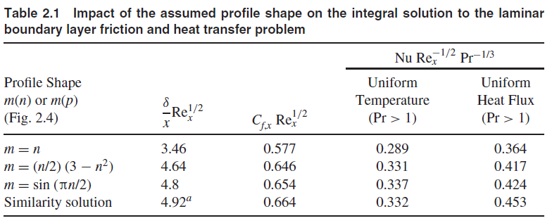

Slide 8
Similarity solutions
The basic idea in the construction of these solutions is the observation that from one location x to another, the u and T profiles look similar (hence, the name similarity solutions)
Geometry, similarity, pattern and design (drawing) are at the core of science
Velocity profile
Mathematically, the stretching of a master velocity profile amounts to writing
where the similarity variable η is proportional to y and the proportionality factor
depends on x.

Slide 9
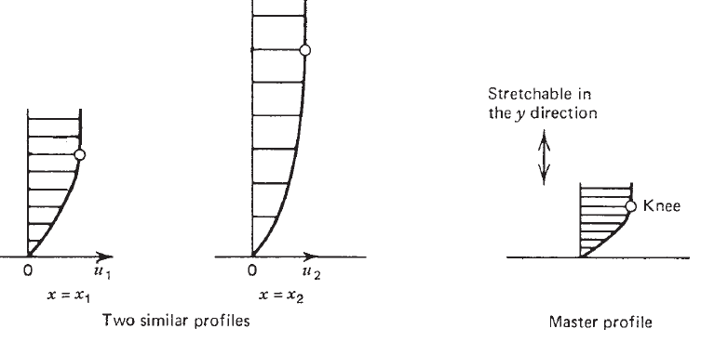
Construction of similar profiles in the analysis of velocity boundary layers.

Slide 10
where the similarity variable η is proportional to y and the proportionality factor depends on x.
Let,
Substituting into momentum BL equation we will eventually get the Blasius equation as
With boundary condition as ,
u=0 at y=0
v=0 at y=0
u→u∞ at y→∞
Where,
and

Slide 11
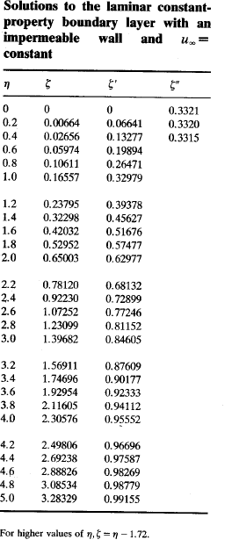
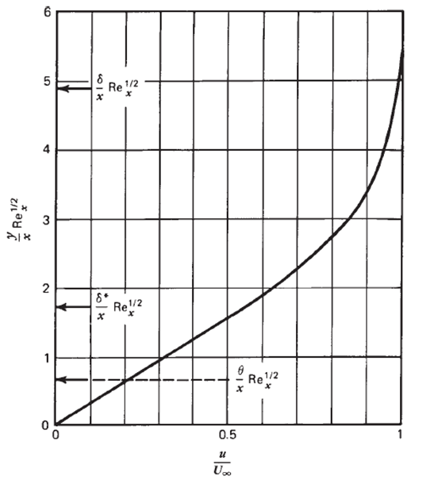

Slide 12


Temperature profile
The heat transfer part of the problem was solved along similar lines.
Introducing the dimensionless similarity temperature profile
The boundary layer energy equation assumes the form
With, boundary condition as

Slide 13

Solution gives

Slide 14





The local Nu can be defined as
Pohlhausen calculated several θ'(0) values that for Pr > 0.5 are correlated accurately by
Gives
The average heat flux obtained in this manner can be non-dimensionalized as the overall Nusselt number:
Gives

Slide 15
Limitations
In concluding this section, it is worth noting the imperfect character of boundary layer theory and the approximation built into the exact similarity solution.
Examination of the Blasius solution for the velocity normal to the wall shows that v tends to a finite value, 0.86U∞ Re_{x}^{−1/2}, as η tends to infinity.
Because in boundary layer theory v/U∞ ∼ Re_{x}^{−1/2} as η → ∞, this theory becomes ‘‘better’’ as Re_{x}^{1/2} increases, that is, as the boundary layer region becomes more slender.
Other limitations of the theory is the breakdown of the slenderness feature in the region near the tip.

Slide 16
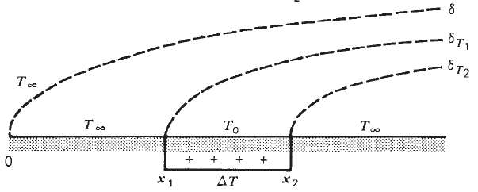
Assignments
Find the hydrodynamic boundary layer thickness (δ), thermal boundary layer thickness (δ_{T}), wall share stress (τ) and heat transfer coefficient for the following cases
1. When the flat plate is heated at different sections with uniform temperature difference as presented in the figure 1.
Figure 1. Arbitrary wall temperature

Slide 17
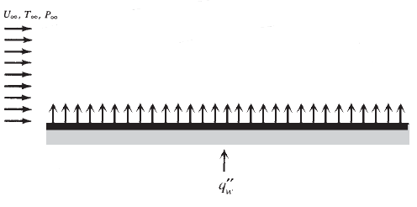
2. The flat plate is heated with an uniform heat flux as presented in figure 2.
Figure 2. Uniform heat flux
3. A hot flat plate with uniform temperature T₀ (> T∞ ) is placed in a stream of uniform pressure gradient.
Hint: Assume

Slide 18
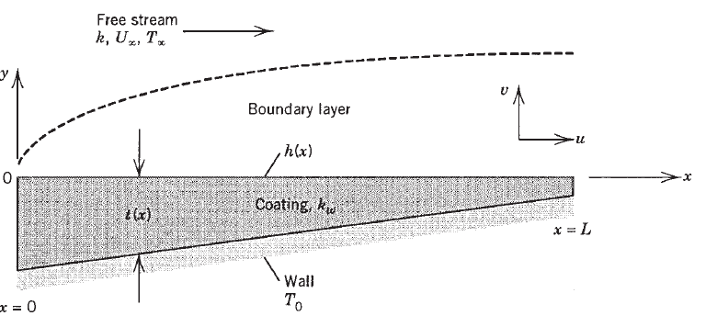
4. Fluid is flowing into or out of the wall surface.
Hint: The wall surface will have normal velocity v₀(x). That can be positive or negative depending on the situation.
Positive v₀ values indicate blowing, that is, the injection of fluid (the same fluid type as in the free stream) from the wall into the boundary layer. Negative v₀ values represent suction, the removal of some of the boundary layer fluid by forcing it to flow through the porous surface of the wall.
5. The flat plate in is an isothermal wall ( with T₀ temperature ) and coated with a layer of solid material of thermal conductivity k_{w}. The layer thickness may be nonuniform, t(x); however, it is sufficiently smaller than the wall length L so that the effect of longitudinal conduction through this layer can be neglected.
Figure 3. Laminar boundary layer flow over an isothermal wall coated with a solid of variable thickness.

Slide 19


Problem 2
It has been claimed that a similarity solution does not exist for the laminar thermal boundary layer over a flat plate with uniform heat flux Develop this similarity solution for the flat plate geometry. As a similarity temperature variable, choose θ(η,Pr), where
Show that the energy equation in the boundary layer reduces to

Slide 20
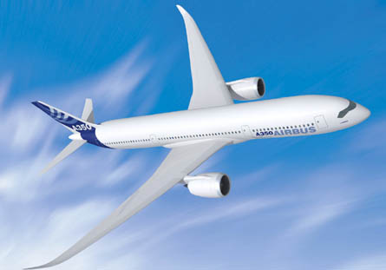
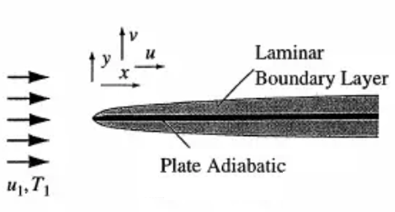
Problem 3
Consider the flow of air which has a free stream temperature of O°C over the adiabatic Airplane wing as shown in Figure. If the flow in the boundary layer can be assumed to be laminar, determine how the temperature of the wing surface varies with Mach number. Assume Pr=0.7, γ=1.4 for air.

Slide 21
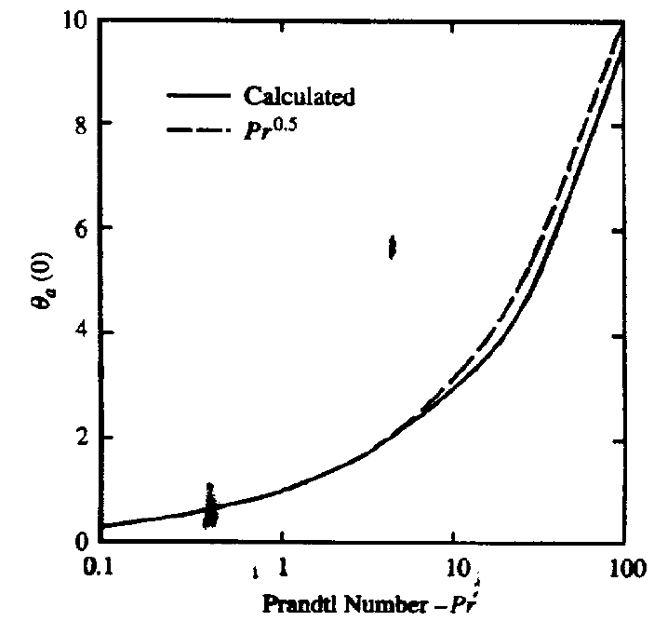

Slide 22
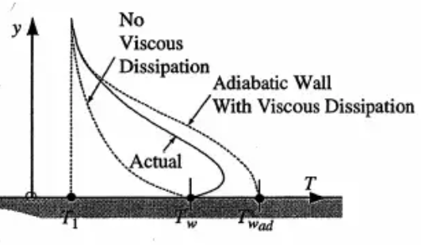
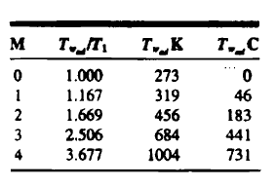
Temperature distributions in a laminar boundary layer with and without viscous dissipation

